Slide 1
Priorities for Software
Correctness
Performance
Usability
⇒ Once you have a minimal viable product (correctness), make it fast "enough"
⇒ Once it's fast enough, get user feedback to iterate on ease-of-use

Slide 2
Fast Enough
No clear-cut definition, but some factors:
User-perceptible lag (>100 ms)
User-annoying lag (>1000ms)
Common system configurations vs underpowered ones
Time to system failure/interrupt (10 hour download, 72 hour task)

Slide 3
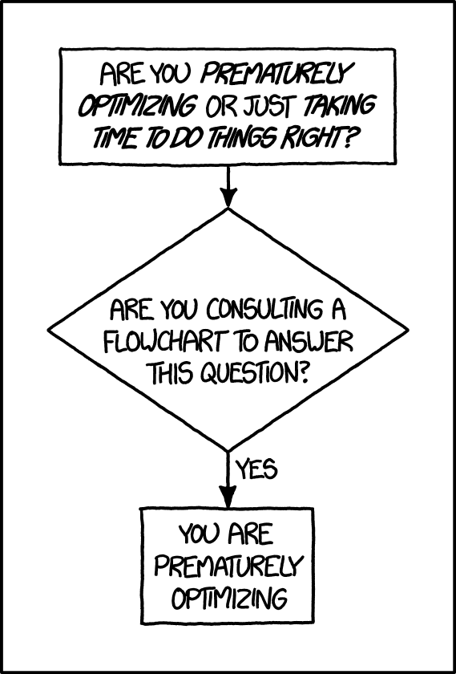
Performance Tuning
Premature optimization is doing performance tuning before you have correctness finished
Grey areas around design decisions
Downsides
Waste of time (bottlenecks don't end up being what you expect)
Complicates code unnecessarily

Slide 4
Performance Tuned Code Gets Messy
// NOT THREAD SAFE. Omits a bunch of checks for the sake of speed, relying on our specific
// calling context
public int readLine(char[] readInto) throws IOException {
int pos = 0;
int startChar;
boolean omitLF = skipLF;
for (;;) {
if (nextChar >= nChars)
fill();
if (nextChar >= nChars) { /* EOF */
return pos;
}
boolean eol = false;
char c = 0;
int i;
/* Skip a leftover '\n', if necessary */
if (omitLF && (cb[nextChar] == '\n'))
nextChar++;
skipLF = false;
omitLF = false;
charLoop:
for (i = nextChar; i < nChars; i++) {
c = cb[i];
if ((c == '\n') || (c == '\r')) {
eol = true;
break charLoop;
}
}
startChar = nextChar;
nextChar = i;
if (eol) {
System.arraycopy(cb, startChar, readInto, pos, i - startChar);
pos += (i - startChar);
nextChar++;
if (c == '\r') {
skipLF = true;
}
return pos;
}
System.arraycopy(cb, startChar, readInto, pos, i - startChar);
pos += (i - startChar);
}
}

Slide 5
Performance Tuning - Why It Matters
Something that's "a little slow" on a dev machine with a fios internet connection is likely unusable on a phone over a 3G network
Global accessibility
Wider user base
Build other components on top of existing software

Slide 6
Constant Factors vs Big-O
We're mainly focusing on constant factors here, but it's worth noting:
An algorithmic improvement is often orders of magnitude faster than tweaking constants
Changing underlying algorithms is non-trivial, though

Slide 7
How to Tune for Performance
Always, always, always measure to see where performance bottlenecks are, do not try to guess.
Real life example: a buggy cache lookup introduced a 30% slowdown to the 'save changes' pipeline (in a situation that auto-saved on keystroke)
Once you know what method causes a bottleneck, then investigate
Having tightly scoped methods helps with this

Slide 8
Performance Issue Causes
Once you have a method that's causing problems, things to look for:
- Loops
- Network calls
- File system writes
- Locking

Slide 9
Performance Issue Causes
Ex: Loops
public void doAThing() {
int start = 0;
for (int i = 0; i < 1_000_000; i++) {
double multiple = Math.pow(3,9);
start *= multiple;
}
System.out.println(start);
}
Factor out common logic from inner loops

Slide 10
Performance Issue Causes
Ex: Loops
public void doAThing() {
int start = 0;
double multiple = Math.pow(3,9);
for (int i = 0; i < 1_000_000; i++) {
start *= multiple;
}
System.out.println(start);
}
Better: multiple only gets calculated once

Slide 11
Performance Issue Causes
Ex: Network Calls
Cross-network APIs (should) provide a batch/bulk read option, use that for large amounts of data
public List<String> loadDatabaseTable(Database db, String table) {
List<String> loadedData = new ArrayList<>();
int numRows = db.getSizeOfTable(table);
for (int i = 0; i < numRows; i++) {
loadedData.add(db.getRow(table, i));
}
return loadedData;
}

Slide 12
Performance Issue Causes
Ex: Network Calls
Better: only 1 + #pages network calls, plus bonus avoid resizing the list
public List<String> loadDatabaseTable(Database db, String table) {
int numRows = db.getSizeOfTable(table);
List<String> loadedData = new ArrayList<>(numRows);
Iterator<String> rowCursor = db.getRows(table);
while (rowCursor.hasNext()) {
String row = rowCursor.next();
loadedData.add(row);
}
return loadedData;
}

Slide 13
Performance Issue Causes
Ex: File System Writes
public void writeSomeData(FileWriter out) throws IOException {
for (int i = 0; i < 10; i++) {
String largeDataBlob = expensiveCalculation(i);
out.write(largeDataBlob);
}
}
Several solutions:
Producer/Consumer pattern
Buffering (some built in, but might need more)

Slide 14
Performance Issue Causes
Ex: File System Writes
public void writeSomeData(BufferedWriter out) throws IOException {
for (int i = 0; i < 10; i++) {
String largeDataBlob = expensiveCalculation(i);
out.write(largeDataBlob);
}
}
Better: Default buffer size for BufferedWriter is 8k, vs 1k for FileWriter
⇒ Often, performance tuning means poking under the hood for library classes

Slide 15
Performance Issue Causes
private int currentCount = 0;
public int doARead(Semaphore lock) throws InterruptedException {
lock.acquire();
try {
return currentCount;
} finally {
lock.release();
}
}
public void doAWrite(Semaphore lock) throws InterruptedException {
lock.acquire();
try {
currentCount++;
} finally {
lock.release();
}
}
Ex: Locking
If threads spend a lot of time in blocked wait, revisit ways to improve parallelism

Slide 16
Performance Issue Causes
private int currentCount = 0;
public int doARead(ReadWriteLock lock) throws InterruptedException {
lock.readLock().lock();
try {
return currentCount;
} finally {
lock.readLock().unlock();
}
}
public void doAWrite(ReadWriteLock lock) throws InterruptedException {
lock.writeLock().lock();
try {
currentCount++;
} finally {
lock.writeLock().unlock();
}
}
Ex: Locking
Better: Use a ReadWriteLock to allow multiple reads at once

Slide 17
Your Turn!
Clone the PerformanceTuningExercises repo from the link on Brightspace
Find the thisMethodIsTooSlow method in the exercise1 package
Change the method in a way that's likely to make it run faster (we'll cover how to measure that in a bit)

Slide 18
Performance Testing
Benchmarks serve as regression tests for performance
Standard set of operations covering most major behavior
Known amount of time to run
A small standard deviation in the time it takes to run
To run usefully:
Same/similar hardware or environment (virtualization often doesn't work)
Ideally, run many times and averaged (micro benchmarks)

Slide 19
Performance Testing
Always benchmark before and after each change that you make to address a performance issue
Ex:
commit 1 improves performance by 10%
commit 2 degrades performance by 5%
Combined, there's still a performance improvement

Slide 20
Benchmark Tests
Need to compare a baseline to a changed valued
Hardcode (or store in a config file) a known baseline value
similar to 'golden tests' for UI testing
should fail for both sufficiently large improvements and regressions
For end-to-end tests (or localized testing), often possible to run on two different versions within the test and directly compare
Greater resiliency to changing hardware
Auto-updates to new good values, so no need to fail for improvements

Slide 21
Benchmark Tests
How big should a change be before getting flagged?
Depends on the variability within the test (avoid false positives)
Larger values risk creeping slowdowns over time
10% is a common value
combined with comparing to the previous major release as well as previous commits to minimize incremental slowdowns

Slide 22
Performance Trade Offs
Make one part faster in exchange for another part becoming slower.
Ex: Binary Search Tree vs Array List
Insert is slower
Lookup is faster

Slide 23
Performance Trade Offs
Common pitfall: "micro" benchmarks that just test constant factors for very small cases
Make sure you aren't making an already-fast task faster at the expense of a slower task becoming slower
Do not measure performance in nanoseconds - nanos make it hard to tell if you've got a micro benchmark.
For java, use System.currentTimeMillis()
Benchmarks should take 8-60 ms (still fast, slow enough to give real data)

Slide 24
Performance Trade Offs
Document any trade-offs
Typically in comments in the code
For major design decisions that impact how the system is used, document in the README
Ex: 'Using bit-packing here to allow fully in-memory lookups of data' is a good class comment
'Requires running with a jvm with a 32GB heap' should go in the README

Slide 25
Example Benchmark Test
To the IDE!

Slide 26
Measuring Program Performance
Ways to measure performance:
YourKit/instrumentation (YourKit is sadly no longer free)
Timing logging wrappers
System-level utilities (top, iostat, ping/netstat)
When all else fails: kill -3 produces thread dumps and can be called repeatedly

Slide 27
Instrumentation Tools
YourKit - if $ is involved, use this, it's worth it
JConsole
a better UI than kill -3 (and works on Windows)
supports remote debugging
Building block for many frameworks
Included with the JDK

Slide 28
Instrumentation Tools
JConsole limitations
Requires manual steps
Imprecise
⇒ This is a tool to give you a rough idea where to start looking
Do not try to replace benchmarks with JConsole

Slide 29
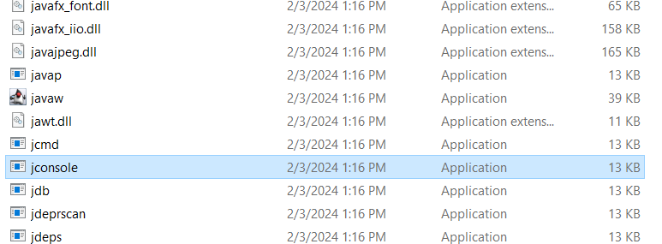
JConsole
Executable (called 'jconsole') located in <path to jdk>/bin

Slide 30
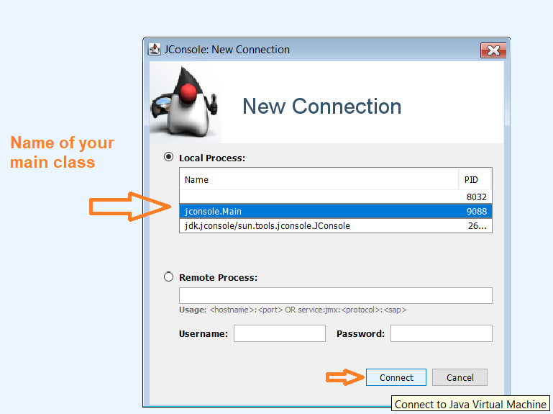
JConsole
For local testing, often helpful to put a breakpoint at the beginning of main until you have JConsole connected

Slide 31
JConsole
For local testing, often helpful to put a breakpoint at the beginning of main until you have JConsole connected
If it complains about no SSL,
that's ok, just use an insecure
connection

Slide 32
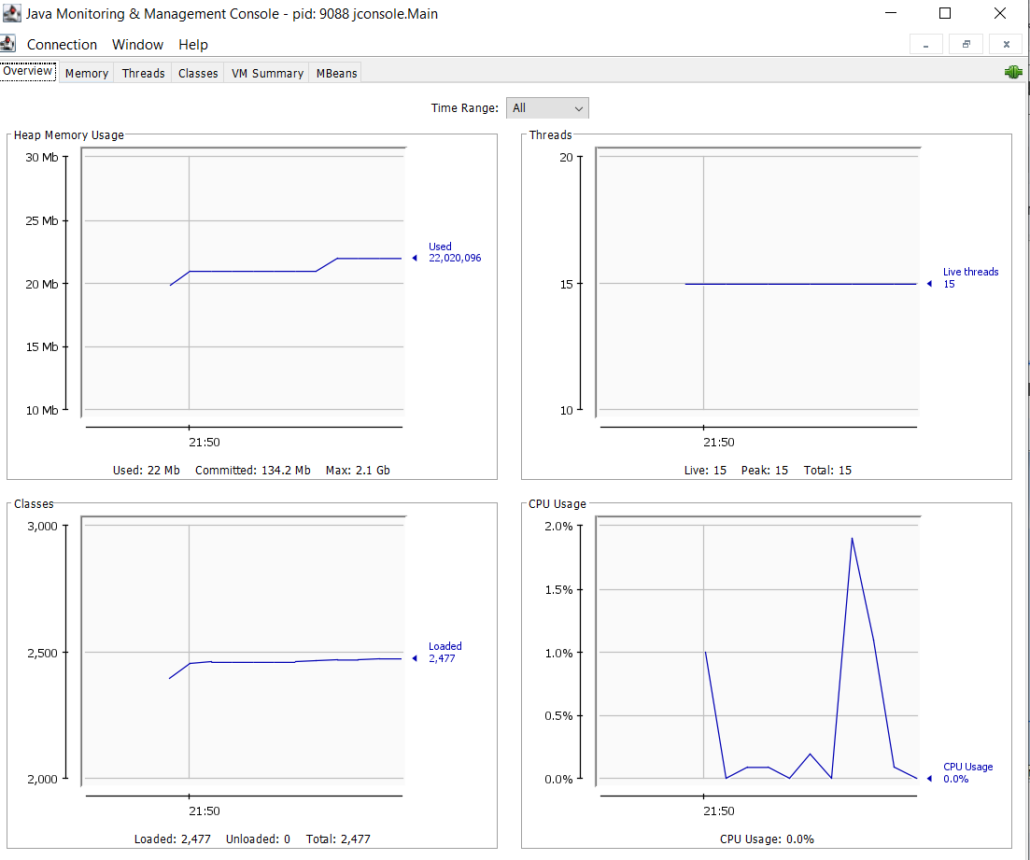

Slide 33
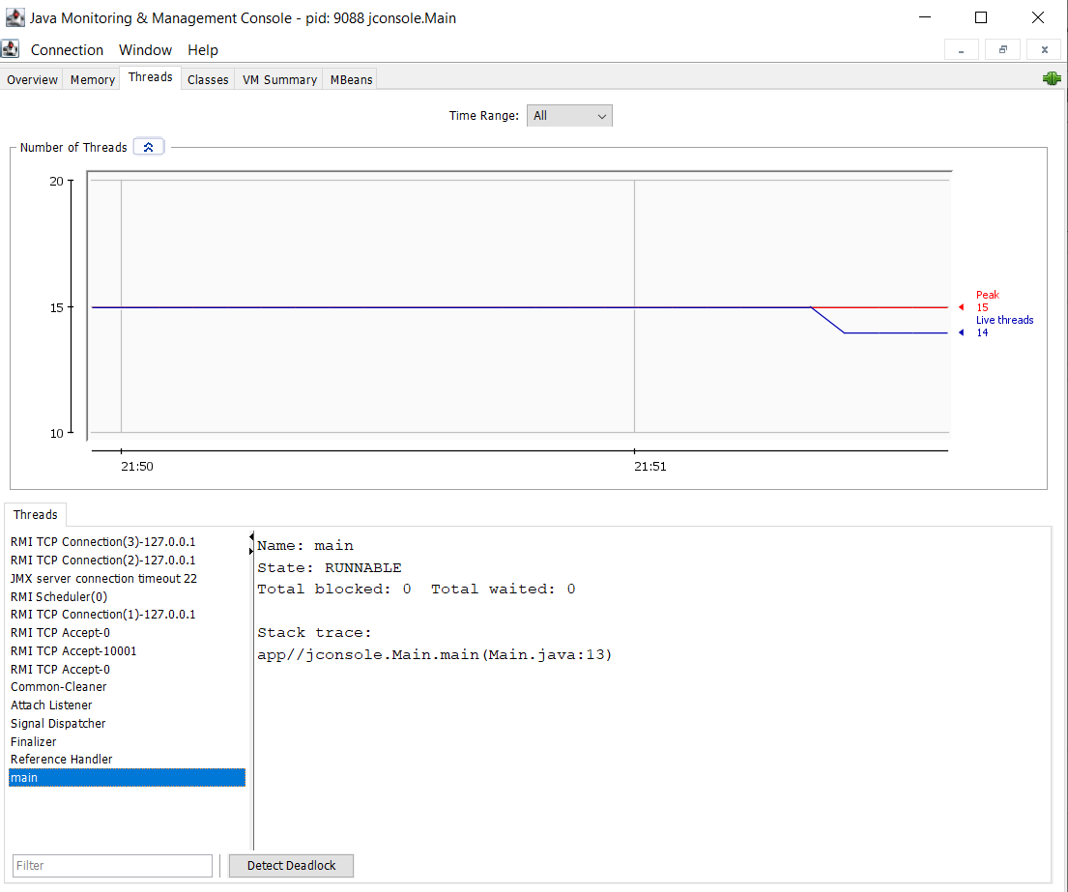

Slide 34
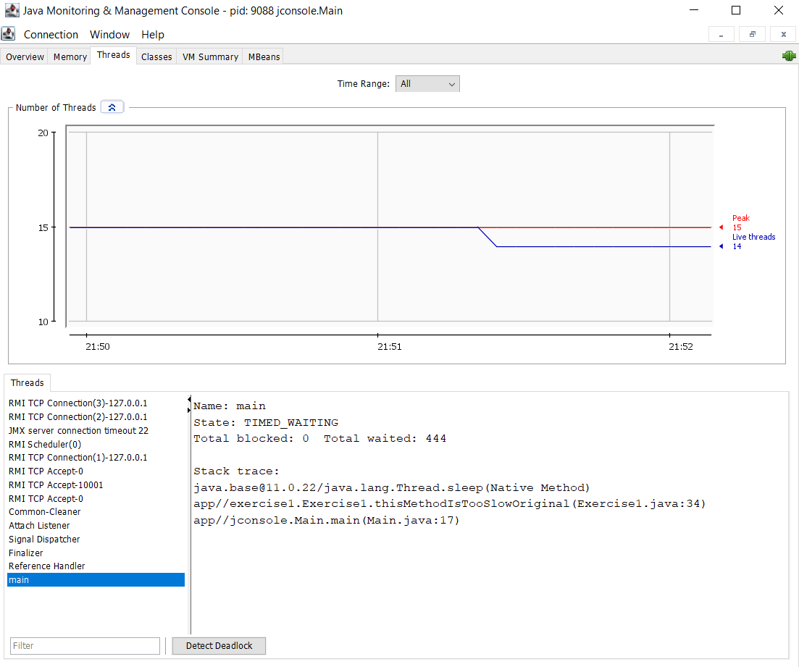

Slide 35
Your Turn!
Start with the code in the exercise2 package
Don't look at the code for MysteryClass yet
Use JConsole to find the method call(s)/section of code in PerformanceTuning.main that's causing a bottleneck

Slide 36
Timing Logging
Pros:
Easier to investigate after the fact
Useful when no remote debugging is possible
Can provide arbitrary details
Cons:
You have to build it or buy it
Be careful the logging itself doesn't cause slowdowns

Slide 37
Timing Logging
Create a wrapper around the relevant code
Based on some condition, record stats on that code
Common conditions:
always
when 'debug' logging is enabled
when a ThreadLocal flag is set

Slide 38
ThreadLocal
Useful type for multithreaded situations
Under the hood, it’s a Map with Thread objects as keys
Can be used like a “global stack” - it’s not a local variable or parameter, but also (effectively) not shared between threads

Slide 39
Timing Logging
Create a wrapper around the relevant code
Based on some condition, record stats on that code
Common stats:
how often it's called
the immediate caller (stack trace)
how long it runs

Slide 40
Timing Logging
Periodically, record the timing logging somewhere
central monitoring server
file system

Slide 41
Timing Logging Example
To the IDE!

Slide 42
Performance Tuning: Caching
Pros:
Avoid doing an expensive operation (network call, file system read, large computation) multiple times
Cons:
Lots of memory
Cache invalidation when data changes

Slide 43
Performance Tuning: Caching
Suppliers.memoize() - since grpc pulls in Guava, this is already on your classpath
Ex: Supplier<Integer> numRows = Suppliers.memoize(() -> loadNumRowsFromDb());
CacheBuilder - more options for complex caches
Most common: maximumSize, expireAfterWrite, expireAfterAccess
Other less common features:
use a "weight" instead of a count (maximumWeight, Weigher)
weakKeys, softValues (less useful for classic caching)

Slide 44
Let's Review
When in the development cycle should you focus on performance tuning
Some factors to consider when deciding if a system needs further performance improvements
Why you should base performance tuning on measurements
What is a benchmark, and how would you create a good one
Common sources of performance bottlenecks
Common tools to detect a bottleneck

